Slide 1
Definitions in
CA-7
Frequently Used Terms in CA-7

Slide 2
CA-7
CA-7 is an online, real time, interactive system which automatically
controls, schedules and initiates work according to time-driven
and/or event-driven activities.
Jobs
Scheduling
Requirement Definitions

Slide 3
Frequently Used Terms
Batch Cycle:
Sequencing of Jobs in order to run is called Batch Cycle.
Here Successive Jobs are initiated automatically when the previous Jobs are completed and all requirements are satisfied.
The initiation of the job is done in two ways:
Time based:- Jobs run based on the time specified in the Job.
Event based:- Jobs are dependent on other Jobs and run only when they are completed.

Slide 4
Definitions:
Schd Id:
A job can be a part of different batch cycles. To run the same job in different batch cycles, we use schid.
Schids can be any number between 1-255.
Every job running in Ca7 Should have a Schid.
Schid is very important when triggers are on.

Slide 5
Definitions:
Dead line Time:
It is the time by which the Job should meet the requirements and should start successfully.
Due Out Time:
It is the time before which the Job should complete successfully.
Elapsed Time:
Average time of last five successful runs of the Job is called Elapsed time and is calculated by CA7.

Slide 6
Definitions:
Submit Time:
It is the time where the Job should get submitted to the Operating System.
Lead Time/ Look Back Time:
It is the time where we can look back for the execution of the Job in the previous run where we can post the requirements if they are met.
Lead time varies from 0 to 99.
0 → Indicates no lead time is to be considered when satisfying this job's requirements.
98 → maximum lead time value is 98 hours.
99 → Each predecessor job must complete normally while this job is in the request queue. This is a special case, even though it is equivalent to zero lead time. Because, the requirement is never to be considered as already satisfied when the job enters the queues.

Slide 7
Definitions:
Restart :
The term restart is interpreted as restarting the job in the step in which it has failed. We can even restart from any other step also.
Restarting a Job in CA-7:
Insert the restart card in jcl and resubmit it in xqm panel.
Restarting a Job in CA-11:
In Ca-11 the step where the Job has to start is already tracked and we have to restart it from xqm panel.
But we can even change the step name from where it should be started.

Slide 8
Definitions:
Trigger :
Used to describe relationships between jobs in the same schedule. For example, job1 can trigger job2. Job2 is then described as having been triggered by Job1.
Job1
Job A
In the given example for Job2, Job1 is called the Predecessor Job and Job3 is called as the Successor Job.
Job2
Job3
Dependencies:
In the above example Job1 has an internal requirement of JobA and Job1 will get posted only when JobA runs successfully. Hence Job1 is said to be dependent on JobA.

Slide 9

Definitions:
Stand Alone Jobs:
Jobs which do not trigger any other Jobs are called as Stand Alone Jobs.
JobA
JobB
JobC
In the above example, Job C is called the Stand Alone Job.

Slide 10
Common CA-7 Terms and Definitions
When a job enters into the CA-7 queue it can complete normally, execute and fail, or wait in the queue until all requirements are satisfied. For jobs that execute and fail the operator can take these actions –
FORCE COMPLETE - A failed job is marked within CA-7 as a normal completion. Jobs waiting for the successful completion of this job will now run - if all other requirements of the job are satisfied.
CANCEL - A failed job is removed from the CA-7 queue. Jobs waiting for the successful completion of this job will not run unless the requirement for the failed job is manually satisfied and if all other requirements of the job are satisfied.

Slide 11
Definitions:
RESTART - The term restart is interpreted as restarting the job in the step in which it has failed.
RE-RUN - The term re-run is interpreted as re-running the job from the top, or first step of the job. RESUBMIT and RE-RUN have the same meaning.
Other common terms include -
SCHID - A schedule or job stream can have many different variations. Each variation is called a schid or schedule id. For example, Job1 may trigger Job 2 on schid 1, but on schid 3 Job 1 may trigger Job 3.
HOLD - A job can be placed on hold before or after it enters the CA-7 queue. The job will remain in hold, meaning it will not run, until the hold is removed.
OVERRIDE - Sometimes it is necessary to modify the regular JCL (referred to a the MASTER JCL). In such cases the term used is OVERRIDE. This process can be done prior to a job executing or after a job has failed, and recovery requires modification to the JCL.

Slide 12
Different Queues in CA-7

Slide 13
Different Queues in CA-7
There are three main queues in CA-7.
    Request Queue
    Ready Queue
    3. Active Queue

Slide 14
Entire Job Flow
Different Queues in CA-7
JOB
Did not find jcl
Skeleton Status
Got Jcl
Request Queue
Ready Queue
spool
Active Queue
Job completed/ Abended
Request Queue
Job went Fine
Lprrn
Lrlog
Restarted
Job Abended?
Restart /
F/C or Cancel
Force Complete
If F/C
Cancel
Cancel

Slide 15
Different Queues in CA-7
Request Queue
Once the job is triggered by the predecessor job,it first comes into the request queue and waits until it meets all the requirements.
When job comes into the request queue with a unique ca7-id and it is same until it is successfully completed or thrown out of all the Queues.
The jobs which are abended also comes into the request Queue with abended status.
Request
Queue
Lq,job=job name
Lreq,job=job name

Slide 16
Request Queue contd….
There are five ways by which the jobs come into the Request Queue
    1. Sscan (scheduled scan)
    2. Auto.
    3. Demand.
    4. Run.
    5. Load.

Slide 17
Request Queue Contd…
Demand Command
Used to force immediate scheduling of a job into the CA-7 request queue.
Syntax: Demandh,job=<job name>,schid=<schid>,set=ntr.
  The above command is to demand a job with no triggers.
To demand a job which needs to be restarted from a particular step.
  Syntax: Demand,job=<job name>,schid=<schid>,type=res
Note:
  Always cross check the SCHID and trigger option before demanding the job.
  Default schid is 001 and with triggers.
  It is always safe to demand a job with hold.

Slide 18
Request Queue Contd…
There are three ways to remove the jobs from the Request Queue.
  Restart :
  Cancel: This command is used to remove the jobs from ca7 request Queue.
    Syntax: Cancel,job=<ca-7- id>,Reason= <text>,force=yes
  Note:Cancellation of the jobs in the Ready Queue or active queue does not cause termination of the jobs execution.
  Using cancel command not only removes the job from request queue but also it doesn't trigger the other jobs.
  Force complete: Force complete will not only mark the status of the jobs in the request queue as complete but also triggers the successor jobs.

Slide 19
Ready Queue
Once the job meets the requirements,the jobs moves from the request queue to Ready Queue.
Normally jobs will not wait in the Ready Queue for a long time.
Different Scenarios where jobs held up in the Ready Queue are:
  Contention
  Initiators are not free
  Jobs with incorrect syntax will hung up in the Ready Queue.
Ready Queue
LRDYP
LRDY

Slide 20
Ready Queue Contd…
When the job is in the Ready Queue,CA-7 will not release the job from the Ready Queue to Spool until it gets all the resources.
If the job is hung up in ready queue for a long time,we will move the job from the ready queue to the Request Queue.
We use Requeue command to move jobs from ready queue to Request queue,
  Requeue,job=(job name/job no),Q=(rdy)
Note: Don’t use Requeue Command when the job is submitted to spool, as it creates one more instance of the job in the Request Queue.

Slide 21
Active Queue
Once the Jobs meets all the requirements and gets all the resources it requires, jobs will move to the Active Queue.
Once the jobs are in the active queue,CA-7 doesn't have control on the jobs and to analyze the jobs in the active queue we need to go to spool.
OS controls the job once it starts on the system, CA-7 captures job status coming from the system.
Active Queue
LQ
LACT

Slide 22
LIST, LQ, LJOB,
LRLOG, LPRRN, LJCL,
FRJOB, FSTRUC, XQM, LSCHD, etc…
CA7 Commands

Slide 23
List of CA7 Commands
Queue : →
LQ
LIST
LRDY
LREQ
LACT
LRDYP
Log/History : →
LPRRN
LRLOG
Prose Check : →
LPROS
LARF
LJCL
LSCHD
LJOB
LWLB
Triggered jobs : →
FRJOB
FSTRUC
CA11 : →
ARTS

Slide 24
List of CA7 Commands
Panel
General CA7 Commands: →
DEMAND
DEMANDH
CANCEL
HOLD
RELEASE
/fetch
ARFP
SUBMIT
RUN
RUNH
Miscellaneous Commands:→
SSCAN
SCHDMOD
CALMOD
SUBTM
REQUEUE
ADDRQ
NXTCYC
JCLOVRD
ARFP
JCL
QJCL
DB
JOBCONN
XQM
XQN
XQJ
XUPD
XRQ
XWLB

Slide 25
SCHEDULING
JOBS can be scheduled in two ways to cause work to be scheduled and initiated:
date/time-driven, and
event-driven facilities.
Use the SCHDMOD command to display the DB.2.7 - Modification to Resolved Schedule Dates screen.
Use the SSCAN top line command to review schedule scan options or to alter the way in which schedule scan performs its scheduling functions.
By combining base calendar and schedule definitions through a resolution process, CA-7 stores information about date/time related work in its database.

Slide 26
SCHEDULING
The jobs can be scheduled to be run in any one of the following category:
1. Daily job 2. Weekly Job 3. Monthly job 4. Annual job
Daily job
Indicates that the user wants to define a daily schedule.
Weekly Job
Indicates that the user wants to define a weekly schedule.
Select Days From SUN through SAT.
Monthly job
Indicates that the user wants to define a monthly schedule.
For Monthly job, at least WEEK(S) and DAY-OF-WEEK (DOW) or RDAY(S) must also be specified if MONTHLY is used.
Annual job
Defines an annual schedule.
If ANNUAL is used, DAY is required.

Slide 27
Some Definition w.r.t Scheduling
ROLL: Specifies the wanted action to be taken when a schedule day falls on a base calendar non-available processing day. This is not used if the DAILY option is used.
If used, the value must be one of the following: B Roll the schedule back to the previous available processing day. F Roll the schedule forward to the next available processing day. N Do not roll. Schedule day must stand. D Do not roll and do not schedule.
INDEX: Specifies an adjustment to schedule days. After exercising the ROLL option, the schedule is adjusted, forward for plus or backward for minus, by the number of working days entered. Size/Type: 4 numeric characters specified as Snnn where S can be plus (unsigned) or minus (-) and nnn can be any integer from 001 to 365.

Slide 28
Late jobs…
Forecasting?
Jobs on Hold…
CA-7 Procedures

Slide 29
Late Job Analysis:
Use LQ,ST=Late,List=Status to List the JOBS in LATE Status with all Requirements
It may be waiting for another internal job also
If waiting for Internal JOB
Check for the job in Request Queue using LQ,JOB=<jobname>
SUBTM RQMT/ Dataset/USER Requirement,etc
Abended Status with some RQMT JCL Error/RSTBL
If not found in Request Queue
Check for LPRRN (Last run) or LRLOG,JOB=<jobname>,Date=*
Check for the FRJOB and Check which job in the Stream is running Currently.
AUTO JOB
Is JOB
AUTO /
DEMD /
SCHD?
SCHD JOB
DEMD JOB
The Job will be demanded when requested
Check for the Scheduling Details LSCHD,JOB=<jobname>,List=cals

Slide 30
Forecasting a Job
FRJOB and FSTRUC
Job A
Job A
Job B
Job B
FRJOB,JOB=Job D
Job C
Job C
FSTRUC,JOB=Job B
Job D
Job D
Job E
Job E
Reverse Structured Format: Job D is triggered by Job C Job C is triggered by Job B Job B is triggered by Job A
Forward Structured Format: Job B is triggering Job C Job C is triggering Job D Job C is triggering Job E

Slide 31
Lead time miss…
External Requirements
check the Lead time
using the db.3.2 / jobconn,job we can view the LDTM (look back time).
Note that, db.3.2 and jobconn,job do the same function; and db.3.6 and jobconn,usr do the same function.
To Put the job on Hold when it is not on the Request queue.
    Use db.3.6 or jobconn,usr panel and add the user requirement.
To add Request / Job dependencies, use the ADDRQ command as follows:
addrq,job=<job name/job num>,depjob=<jobname>,usr=<text>
Add Requirements

Slide 32
Different types of Requirements
Various Requirements can be viewed in XQM Panel
J → internal job requirement
I → Internal Dataset requirement
E →External Dataset Requirement
U → User requirement
N →Network Requirement
S → Submit Requirement
H → Hold requirement
J →JCL Override requirement
V → Manual Verification requirement

Slide 33
JOBS on HOLD:
Different ways to put the jobs on HOLD:
Add the user requirement using ADDRQ command.
Go to XQM Panel and put ‘h’ wherever needed.
Go to Job definition Panel, and mark HOLD as Y. This is to put a job on Permanent hold.
Using DB.3.6, we can add the user requirement.
Use the HOLD command to put the job on hold.
Note: xqm,fill=h is used to put all the jobs on hold in the queue.

Slide 34
CANCEL a JOB
To cancel a Job in the ACTIVE Queue:
Go to Spool & put C or P for that job and Cancel it, and then,
Come to XQM Panel, then Force Complete it.
In General to cancel a Job use the following command:
Cancel,job=<jobname/job no.>,force=yes,reason=<text>
Why Force=Yes, is necessary, when Canceling a Job?
The FORCE=yes option is used when the job is in a skeleton status
or when the Job is running under CA-11. It is used to clear the contents
CMT, else, if the job abends, the job is cancelled, but the contents of
the CMT is not deleted.

Slide 35
Production Library
StageLibrary
Override Library…
Libraries…

Slide 36
Fig: Over view of Stage & Index Library
Case 2:
Copy from Stage index 252 –
save it in index 254 – Run it
Will be Deleted in index 254
Case 1:
Copy from Stage index 252 –
run it –
Will be Deleted in index 252
Request
Queue
In normal case
Production
Library
Index 90
sys6.Override.jcl
Library
Index 254
sys6.stage.jcl
Library
Index 252
Personal
Library
Make a copy to index 252.
Copy done by Developer/owner.
Make a copy to index 254.
Developer/owner doesn’t
know about index 254.
Everyone has access here and so,
we can copy from here.
But simultaneous access by
2 person is not possible
Only CA7 has access here and so,
Prod-Mon Team only
has access here
We don’t have access to
Developer’s Personal Library

Slide 37
Different Methods to run the jobs
To Demand the job with hold from Production library (index 90):
Command: demandh,job=jobname,schid=<Num>,set=ntr,time=****
Note: Set= ntr → will bypass the triggers. It is optional.
Steps to be followed to run the job from Stage library (index 252):
Check whether the job is defined in CA7. → if Ca7 defined Job,then:
2. Steps: JCL →Fetch (from index 252)→ Save (to Index 254) → Demand the Job with / without Hold.

Slide 38
Different Methods to run the jobs
Steps to be followed to run the job from Override library (index 254):
Check whether the job is defined in CA7. → if Ca7 defined Job,then:
2. Steps : JCL →Fetch (from index 252)→ repl (replace in Index 254) → Demand the Job with / without Hold.
Use → JOB, <jobname> → to Check whether the job is defined in CA7.
Note: its advisable to demand the jobs with Hold.

Slide 39
Different Methods to run the jobs Contd…
Steps to be followed to run the abended job →
from Stage / override library (index 252 / 254):
1. Check whether the job is defined in CA7. → if Ca7 defined Job,then:
2. Steps to be followed in Pictorial form:
JCL
JCL Panel
Fetch
Fetch from 252 using JCL panel
QJCL
Go to QJCL Panel
Repl
replace it in Override(254) if to run from override
Resubmit the Job
Use XQM panel to Resubmit the Job

Slide 40
Run the a Non CA7 job
Steps to be followed to run the a Non CA7 job →
1. Check whether the job is defined in CA7 . → if not a Ca7 defined Job,then:
2. Steps to be followed in Pictorial form :
JCL
JCL Panel
Fetch
Fetch from index 252 / 254 using JCL panel
RUN
Run it from JCL panel

Slide 41
ARF
(Automated Recovery Facility)

Slide 42
ARF
ARF is mainly used for CA-7 to monitor exception conditions for production jobs
and to schedule recovery actions to execute when the job abends.
Utility which comes with CA-7
We can write RULES for abended jobs using this Utility.
One ARF RULE can have 7 instructions.
One ARFRULE can be attached to multiple jobs.

Slide 43
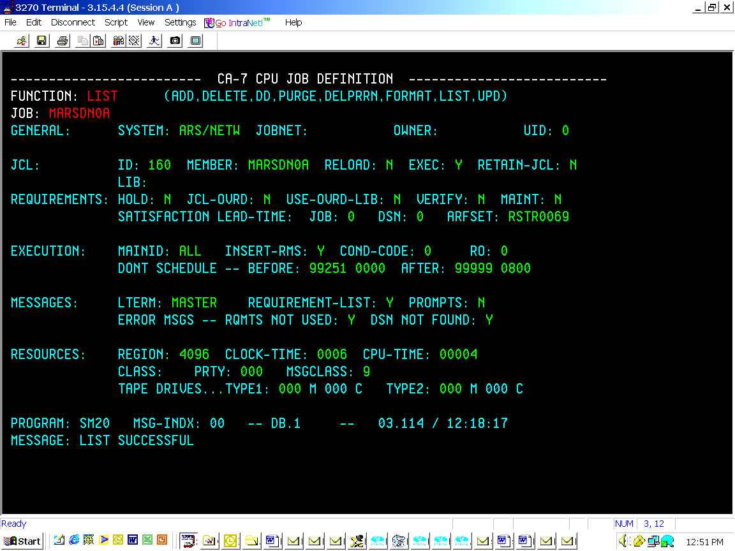
ARF
To know if the job uses ARFSET
Note: Once the ARF rule is attached to the job,ARF works along with the job when the job is submitted to the spool and consumes the CPU resources.

Slide 44
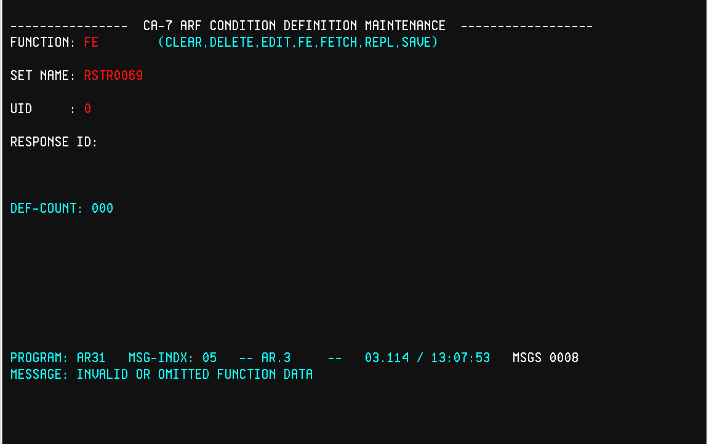
ARFSET
ARF
To view the ARFSET rule defined to job:
Go to ‘AR’ panel, and give the function as shown below

Slide 45
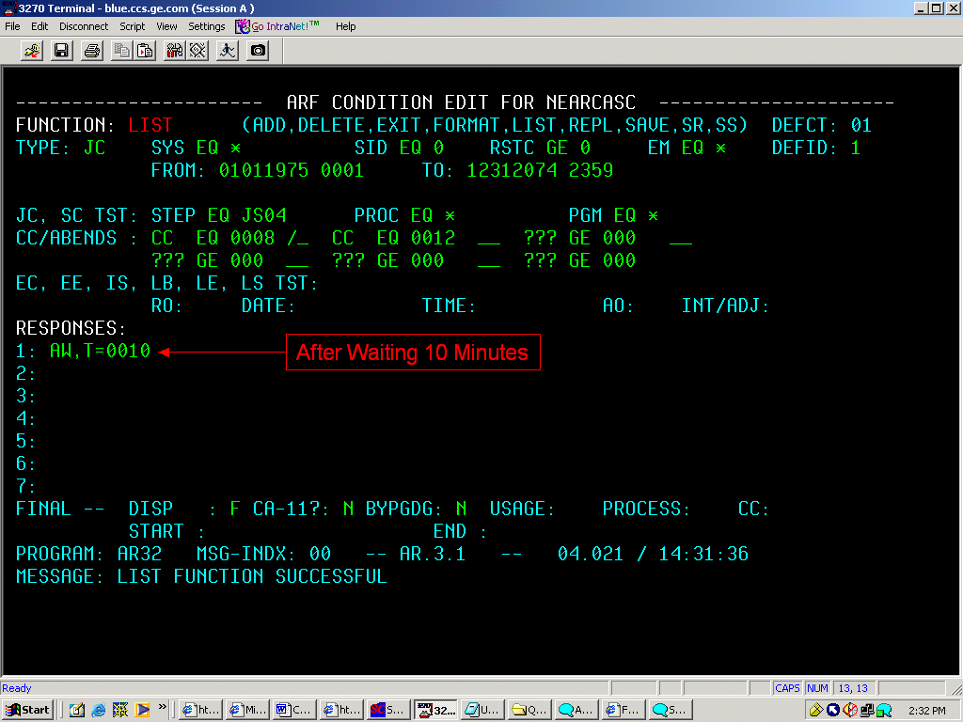
Defining ARF Condition
One RULE can have 7 instructions.
One ARFRULE can be attached to multiple jobs.

Slide 46
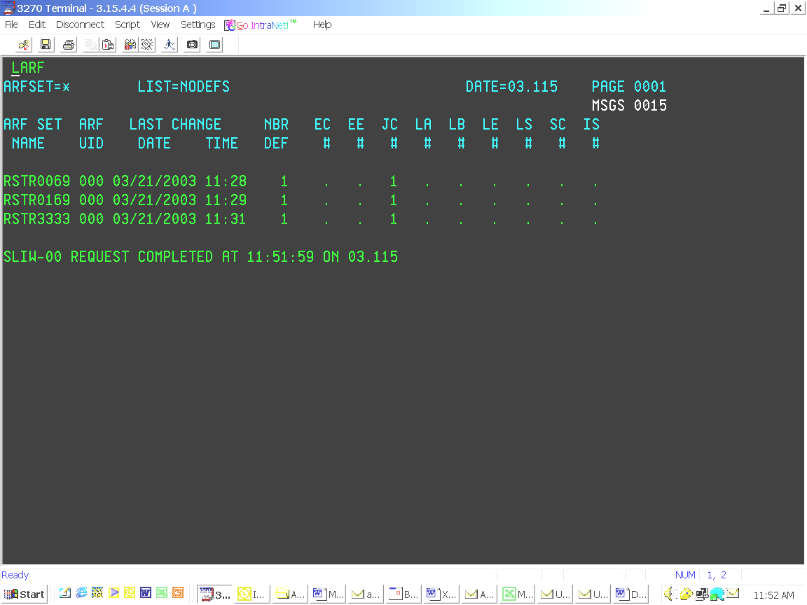
LARF Command
To purge an ARF
LARF Command
THE LARF Command displays information about the ARFSETS from the database
Syntax: LARF,ARFSET=arfset name, LIST=option

Slide 47
To purge an ARF
Use ARFP command to purge an ARF pending on a job.
ARFP,JOB=<job number>,FORCE=YES
JOB NUMBER → Unique CA-7 number of the job for which pending ARF activity is to be purged.
FORCE → Forces the purging of the ARF requirement for a job even if it does not exist in the request, ready, or active queue.

Slide 48
CA-11

Slide 49
CA-11
CA–11 is activated only when the job get the CPU.
CA-11 will create a CMT (CATALOG MANAGEMENT TABLE).
Rules:
  Job should be defined to CA-7.
  Job should be defined to CA-11.
  We need to specify CA-7 that CA-11 tracking is on
When checked in spool will find the step insert@RMS above all the steps of the jcl, inserted by CA-11.

Slide 50
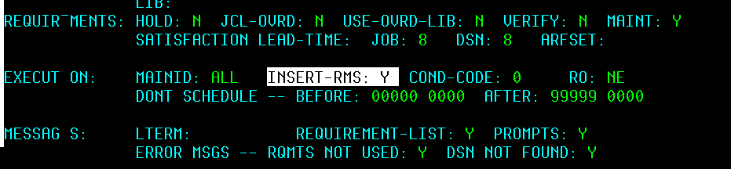
CA-11
INSERT-RMS would be set to Y (Insert-rms:Y)
if CA-11 tracking is on for the job in the job definition panel.

Slide 51
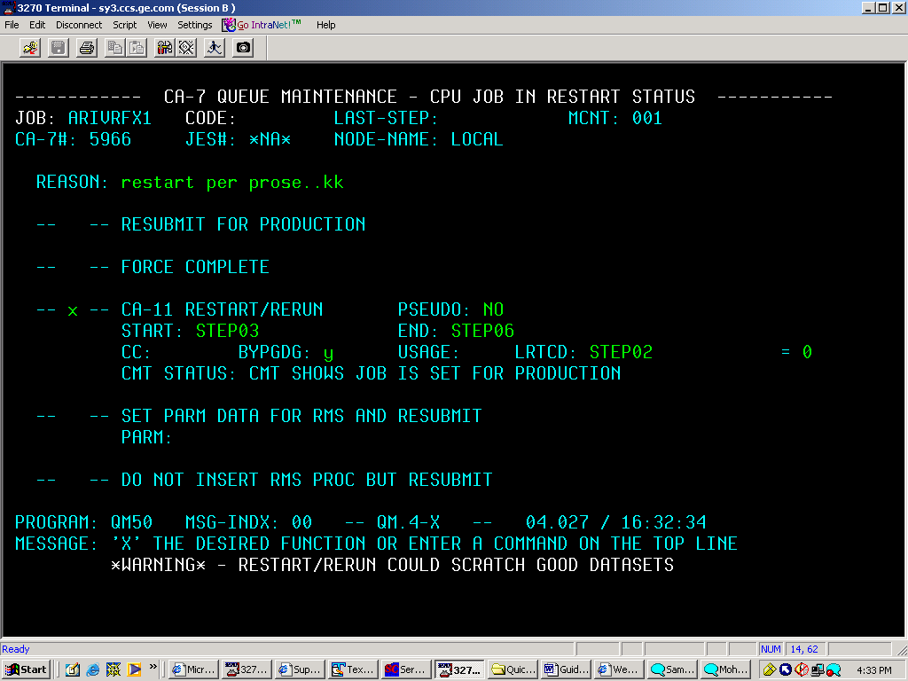
CA-11
If we want to restart the job from some other step than provided by CA11 then override the field START: with override step.
If the User changes or replaces any of the files or the datasets in the JCL then you need to override the field “BYPGDG:” with ‘Y’ so that CA-11 ignores these datasets.

Slide 52
CA-11
Usage of LRTCD and Restart Start
If the User wants to run the job till certain steps then you need to give the step name in the field “START:” where the Job should begin and give the step name in the field “END: “ where the Job should end the processing.
The figure clearly explains the usage of LRTCD and Start in Restart Card
If Restart
After
Abended step?
If Restart
From
Abended step?
yes
insert the step needed to be Restarted in START field.
yes
CA-11 tracks it and so, Restart
Mark the Abended step as 0 in ‘LRTCD’ and so, Restart

Slide 53
CA-11
  “LRTCD:” has to be overridden if there is condition code stated in a particular step of the JCL and the User wants you to restart from that step then you need to give that which satisfies the condition code.
  E.g.:-
  If a job abended at step 4 and we want to restart the job from step 6.Then the restart step should be changed to 6, and LRTCD should be LRTCD: step 4 = 0.So that the return code of step 4 would be changed to 0 (success), so that all the other steps from step 6 will run, otherwise all the steps after step 4 will also be flushed.
ARTS:
If you have installed the CA-7 & CA-11 interface, then you can use the ARTS command to interface directly with CA-11.

Slide 54
CA-11
To check whether the step is restartable or not,we need to enter CA11 by using the ARTS command.
LSTP Command in CA-11:
LSTP, jobname [,startstep] [,end step]
Used to inquire on the steps within a specific job and display their restart status in the CMT.

Slide 55
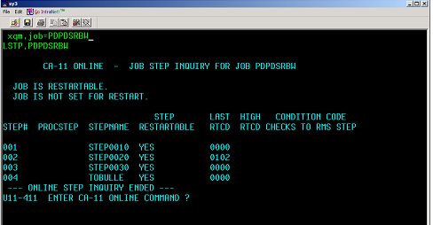
CA-11
LSTP Command in CA-11

